Slide 1
BIO TRIBOLOGY
09/04/2018
Clint Antony Maturi Hari Chaitanya
Gumpula Aravind Mohammed Iqbal

Slide 2
BIO-TRIBOLOGY
Tribology comes from the Greek word “tribos,” which means “to rub.”
Tribology is generally defined as the study of three areas — friction, lubrication and wear.
Generally, friction is produced when two sliding surfaces come into contact, resulting in wear.
The purpose of tribological research is to minimize friction and wear.
Bio-tribology is a relatively new term, a multidisciplinary subject covering the areas of engineering, material science, biological science, physical science and medicine.

Slide 3
SHOULDER WEAR TEST
Mohammed Iqbal 131501019
09/04/2018

Slide 4
INTRODUCTION
Shoulder Joint Replacement is the third most common ortho-paedic joint replacement after hip joint replacement.
There are two type of SJR. Total Shoulders and Reverse Shoulder.
Most SJRs generally employ a cobalt Chromium component rubbing against Ultra-High Molecular Weight Polyethylene (UHMPWE) as an articulation
Wear of this polyethylene glenoid component elicits and osteolytic response to the wear particles, leading to aspetic loosening of the joint.

Slide 5
Testing
Newcastle Shoulder Wear Simulator
The first multi-station shoulder simulator capable of applying physiological motion in three axes with physiological loading.
The three axes of physiological are
Flexion/Extension, Abduction/adduction, Intenal-external rotation
It was used to wear test commercially available JRI Orthopaedics 42mm diameter Reverse VAIOS shoulders using three axes of physiological motion with physiological loading. In addition to it, translational sliding motion was therefore added to the simulator to wear test

Slide 6
Mechanism (Newcastle Shoulder Wear Simulator)
It has 5 articulating stations and one static control station.
Axial loading to each implant is applied using a pneumatic cylinder.
Three pneumatic cylinders with integral position encoders move five glenohumeral prostheses simultaneously in the flexion-extension, abduction-adduction, and internal-external rotation axes.
A mechanism with a rotational centre eccentric to the internal-external axis, and driven by the internal-external motion was built into the components between loading cylinder and lubricant bath to provide translational sliding motion to each test station.

Slide 7
EXPERIMENT
A 5 million cycle wear test was performed with JRI orthopaedics Total VAIOS shoulder.
These consist of a CoCr humeral head articulating against an UHMWPE glenoid component.
Five 42 mm diameter Total shoulder were tested and a sixth was subject to dynamic loading in the control station.
Lubricant employed was newborn calf serum diluted to give a protein content and maintained at ambient temperature.
Gravimetric measurements were used to determine the weight change and thus the wear of components.

Slide 8
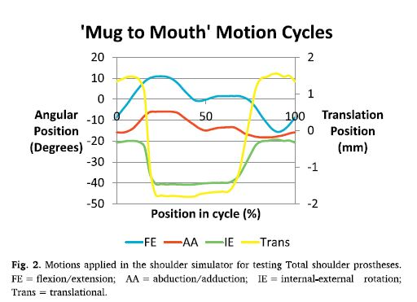
EXPERIMENT

Slide 9
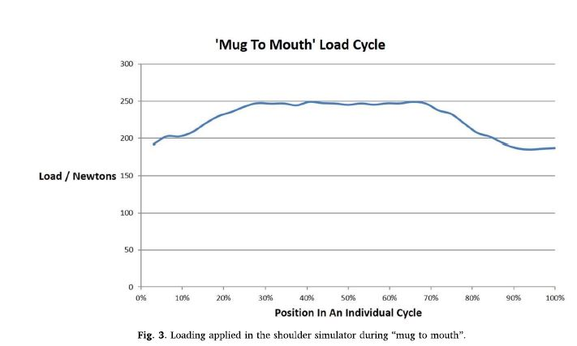
EXPERIMENT

Slide 10
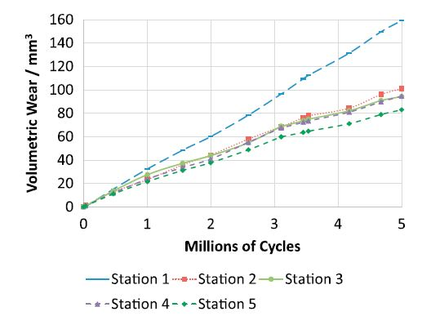
Results

Slide 11
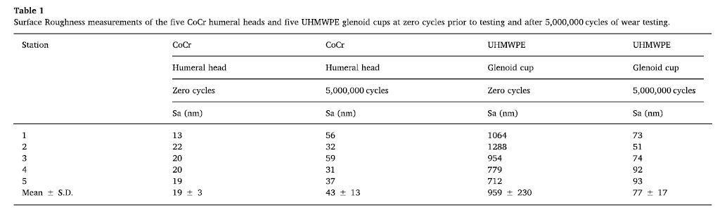
Results

Slide 12
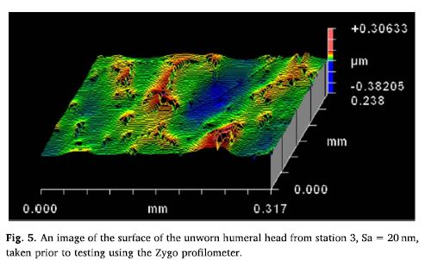
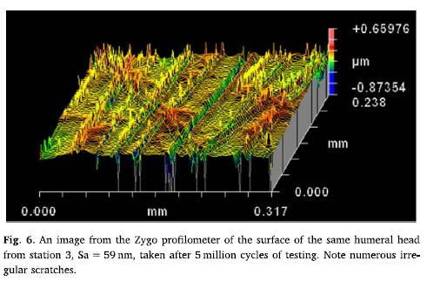
Results

Slide 13
CONCLUSION
The total VAIOS shoulders, tested with the addition of translational motion, exhibited a 50% larger wear rate.
CoCr joints articulating against UHMWPE operate in a mixed lubrication regime where the majority of the load across the joint is carried by asperity contact hence wear of the joint is typical of a boundary lubrication regime where Lancaster equation is applicable.
V = kPx V- Volume of the material removed by wear
k – wear factor
P – Applied load
x – Sliding distance

Slide 14
Questions
In Newcstle shoulder wear simulator, a load of 25N is applied and the translational distance of 3 cm was found. If the coefficient of wear factor is 0.3 calculate the wear volume rate.
2. Why newborn calf serum is used as lubricant in the experiment?
This lubricant supplies protein which get precipitated at higher temperature which reduces the wear.

Slide 15
CARTILAGE AND JOINT LUBRICATION - BIOTRIBOLOGY
Gumpula Aravind 131501012
09/04/18

Slide 16
INTRODUCTION
Cartilage is highly stressed material
Articular cartilage is found in synovial joints
Provides remarkably low friction coefficients under wide range of load and speed conditions
However when loading over longer time scales, these low initial friction coefficients increased by more than an order of magnitude as the applied load slowly wrung the interstitial fluid from the tissue (dehydration)

Slide 17
These unusual tribological properties are primarily attributable to its unique biphasic structure i.e., interstitial fluid phase and porous permeable solid phase
To understand the cartilage response to stress: compression, tension and shear are considered
Functions of Articular Cartilage :
Increases load distribution area
Allow movement while reducing friction and wear

Slide 18
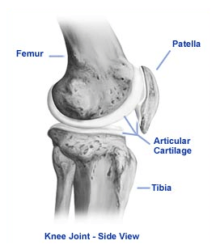
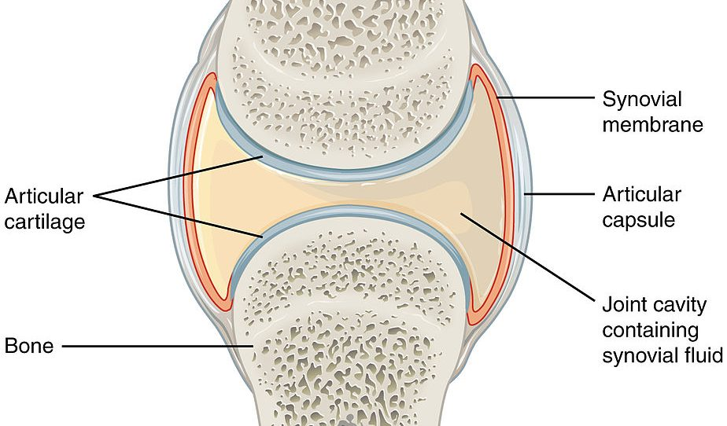

Slide 19
Hydrodynamic lubrication plays an important role in lubricating the joints
Because of the fibrillar nature of the collagen matrix, and since fibrils can resist tensile loads much better than compressive loads, cartilage exhibits a much higher stiffness in tension than compression, a phenomenon that has been called tension-compression nonlinearity
Creep is the tendency of a solid material to move slowly or deform permanently under the influence of mechanical stresses. It can occur as a result of long-term exposure to high levels of stress that are still below the yield strength of the material

Slide 20
Interstitial fluid load support concept
In a creep test, upon the application of a constant load, the pressure was observed to rapidly rise to a value equal to applied compressive stress, before slowly subsiding back to zero at a rate comparable to that of the creep deformation
Since the fluid pressure is equal to the applied stress upon the initial load application, whereas the creep deformation is zero, we can conclude that all of the applied load is initially supported by the pressurized interstitial fluid, and none by solid matrix deformation

Slide 21
As the time progresses, the pressurized interstitial fluid flows out of the tissue, through the porous indenter, leading to a progressive reduction in the fluid pressure and increase in solid matrix deformation
Thus, the load becomes progressively more supported by the solid matrix.
This concept of load sharing between the solid and fluid matrix is called interstitial fluid load support, which plays an important role in the friction response of articular cartilage
Ratio of interstitial fluid pressure to applied stress is called Fluid load support

Slide 22
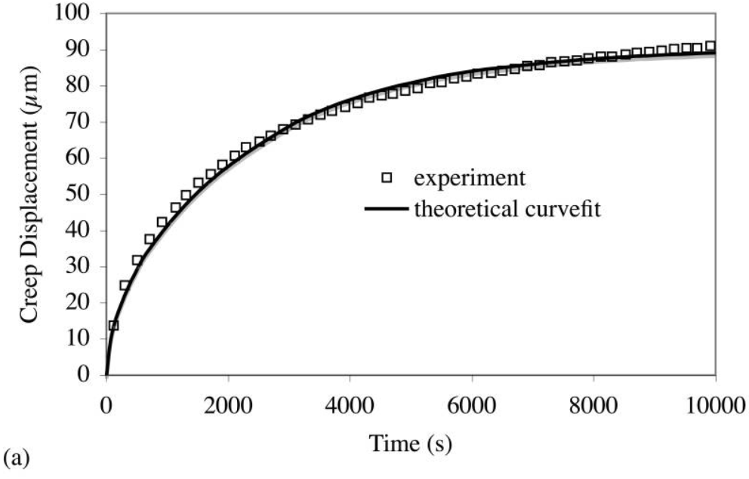
(a) Creep deformation versus time

Slide 23
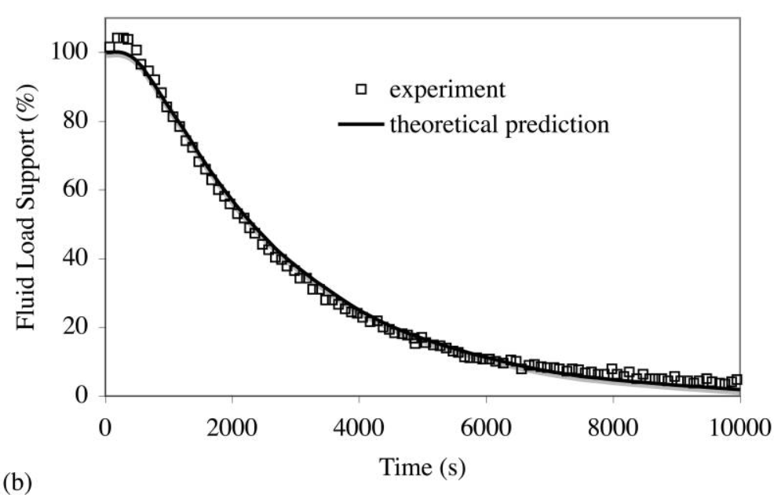
(b) Ratio of interstitial fluid pressure to applied stress

Slide 24
Some experiments were done to measure the frictional response of cartilage against cartilage, using bovine shoulder joints with a variety of testing conditions, including variations in the magnitude and temporal profile of the applied load, the sliding velocity, and the role of synovial fluid versus saline as a lubricant. Based on the experimental observations, the response of cartilage could be attributed to the biphasic nature of cartilage.
The results conclude that the friction force at the articular surface was proportional to the load carried by the solid phase.

Slide 25
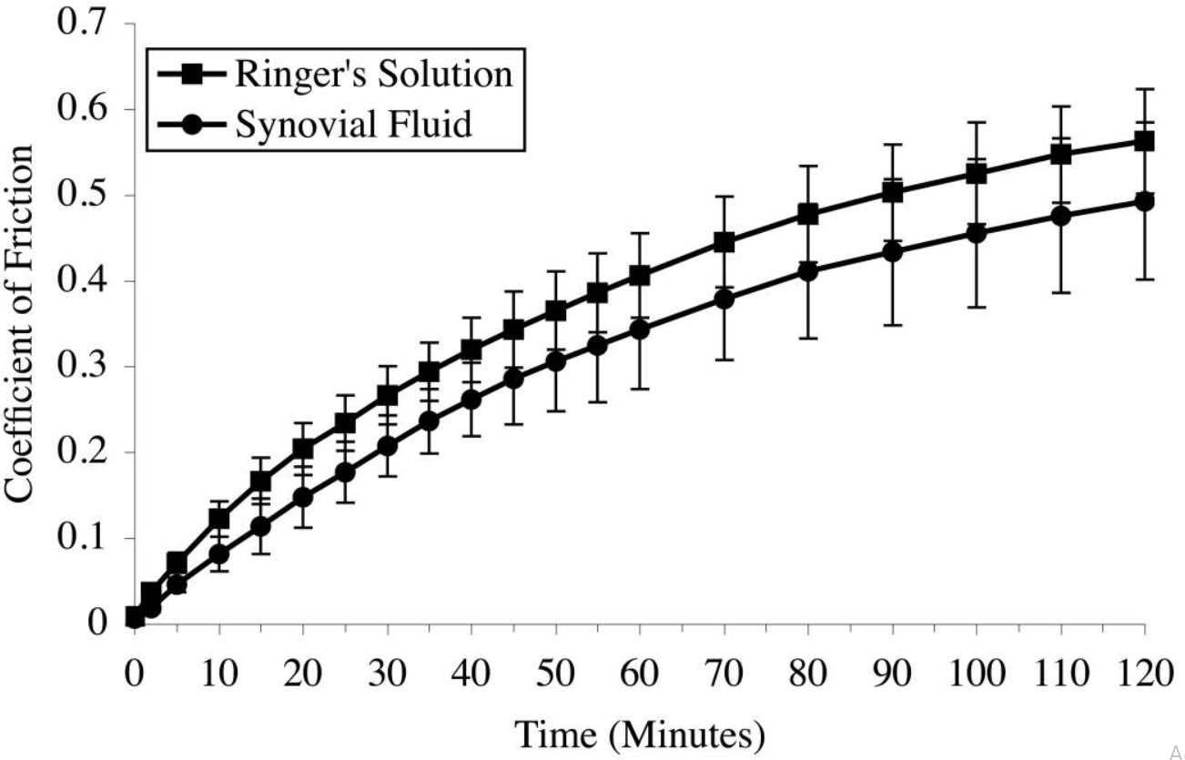
Time-dependent response of the friction coefficient of articular cartilage plugs (∅9 mm) against a metal counterface, under a constant applied load of 30 N

Slide 26
Experiments also performed by testing the frictional response of cylindrical bovine cartilage plugs against glass, under unconfined compression creep. It was observed that the friction coefficient of cartilage rises over time, from an average of μ_{min} = 0.010 to μ_{eff} = 0.24 over a median time of 75 minutes. Furthermore, they observed that the interstitial fluid load support (W^{p}/W), simultaneously decreased from 89% to 9%.
Variation of both friction coefficient and interstitial fluid load support with time is shown below

Slide 27
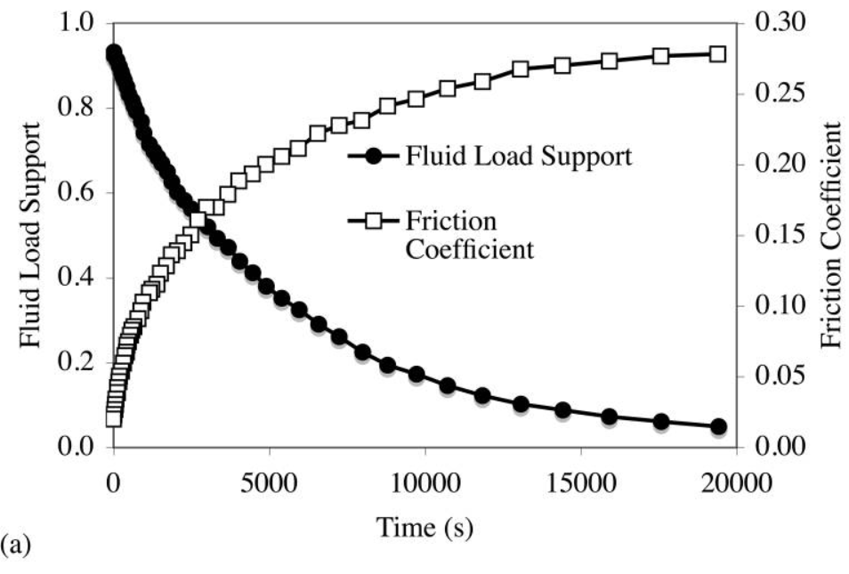
Time-dependent response of the friction coefficient μ_{eff} and interstitial fluid load support W^{p}/W of articular cartilage plugs against glass under constant load of 4.5 N

Slide 28
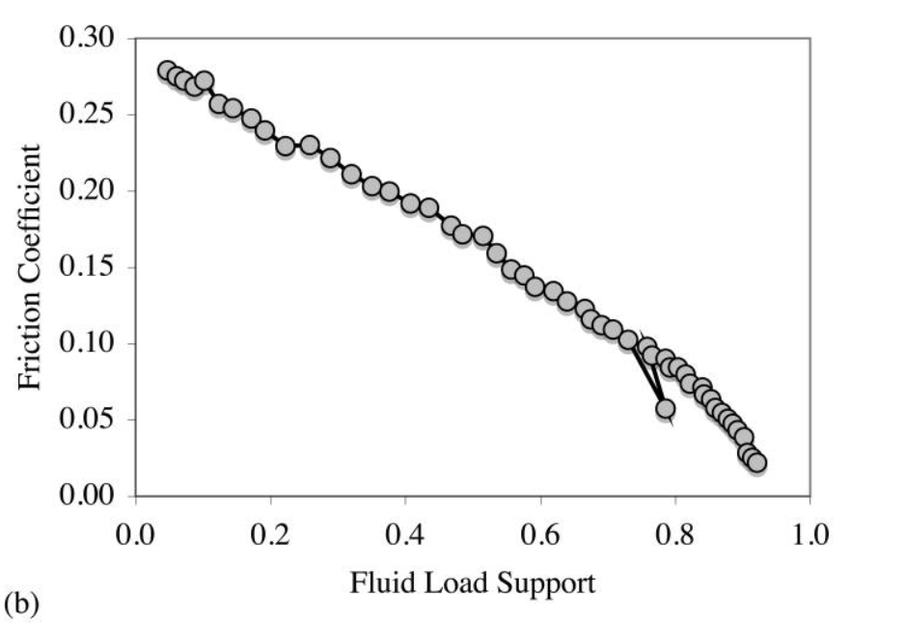
(b) A plot of μ_{eff} versus W^{p}/W yields a linear variation

Slide 29
Since physiological loading conditions generally involve cyclical and intermittent loads, it was hypothesized that dynamic compressive loading of a disk of cartilage may sustain dynamic interstitial fluid pressurization indefinitely, always keeping the friction coefficient low.
This hypothesis was tested experimentally and, contrary to expectation, the friction coefficient of cartilage against glass under dynamic loading was observed to rise at the same rate as under static loading, while fluctuating above and below the static loading value.
For example, under cyclical loading at 0.5 Hz, static loading produced an equilibrium friction coefficient of μ_{eq} = 0.15, while dynamic loading achieved a steady-state cycle where μ_{eff} fluctuated from 0.08 to 0.36.

Slide 30
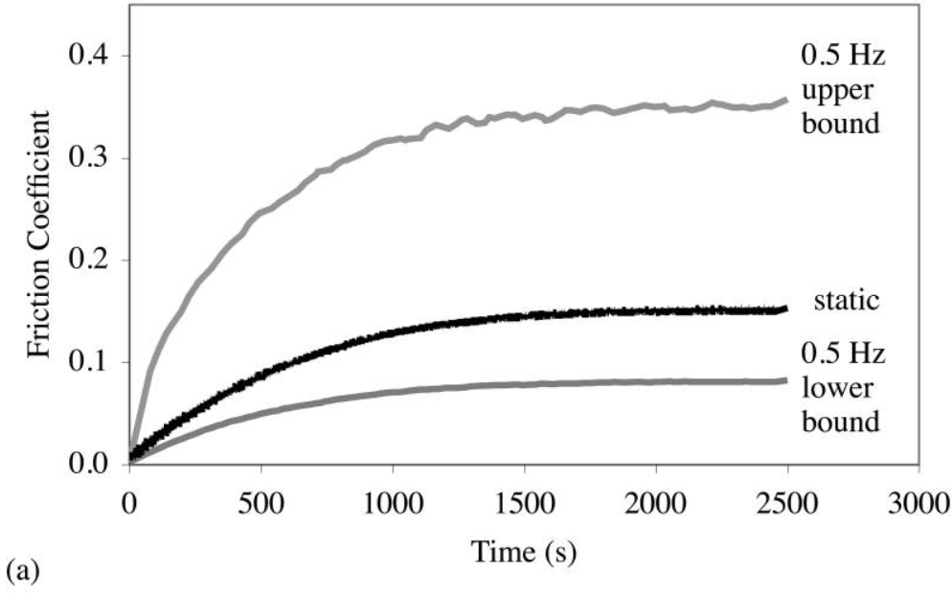
(a)Experimental measurements of the coefficient of friction of a cartilage plug (∅4.8 mm) against glass, under a constant load of 13.4 N, or a sinusoidal load varying from 4.5 N to 22.3 N

Slide 31
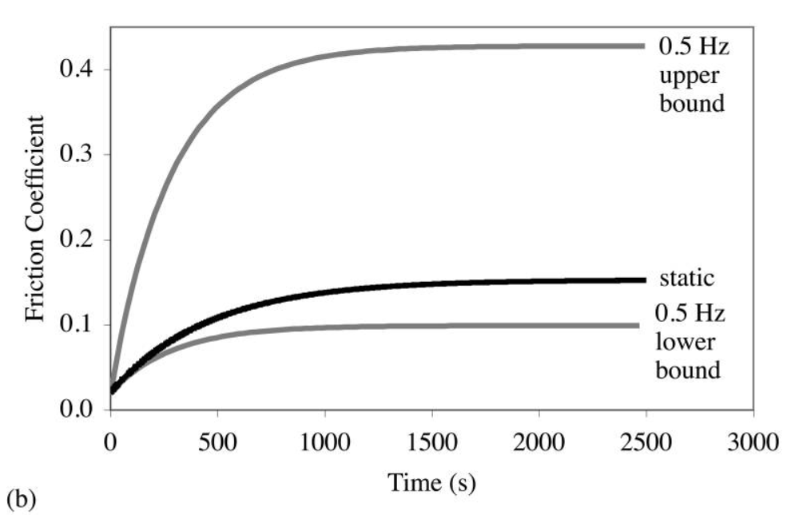
(b) Theoretical predictions of the friction coefficient

Slide 32
If the hydrodynamic pressure in the vessels increases, blood pressure increases due to which the blood supply will be low and hence the cartilage degenerates
If the hydrostatic pressure increases, accumulation of fluid takes place due to which swelling of the part happens and thus the bone movement reduces

Slide 33
Questions
1. Which lubrication plays an important role in lubricating the joints?
A. Hydrodynamic (interstitial) lubrication plays an important role because it takes pressure after synovial fluid flows out under application of load.
2. Why did cartilage exhibits a much higher stiffness in tension than compression?
A. Because of the fibrillar nature of the collagen matrix, and since fibrils can resist tensile loads much better than compressive loads, cartilage exhibits a much higher stiffness in tension than compression.
3. Upon application of constant load, why does the interstitial pressure falls to zero after rapid rise?
Interstitial pressure falls to zero because after reaching to value equal to applied compressive stress, the pressurized interstitial fluid flows out of the tissue through porous intender, leading to a progressive reduction in the fluid pressure and increase in solid matrix

Slide 34

OCULAR TRIBOLOGY

Slide 35
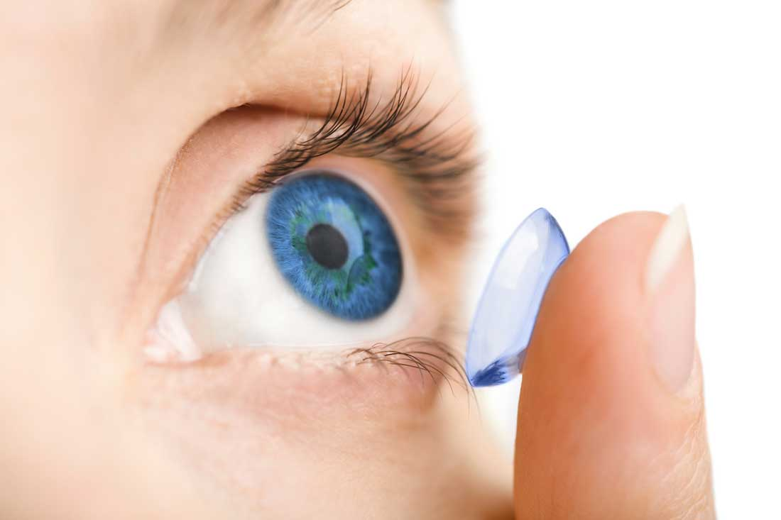
Introduction
Ocular tribology is concerned with the mechanisms of contact lens lubrication
A contact lens is a small lens worn directly on the surface of the eye to aid or correct defective vision.
Modern contact lenses are of two main types – soft and rigid gas permeable (RGP)
They are considered as medical devices and can be worn to correct vision, for cosmetic or therapeutic reasons.
The average age of contact lens wearers globally was 38 years old as of now.
Notes:
Lens is a piece of transparent material having at least one curved surface and which is used to produce an image or otherwise focus light by refraction.

Slide 36
Types of contact lenses
Soft contact lenses
Rigid gas permeable (RGP) contact lenses
Daily wear contact lenses
Extended wear contact lenses
Toric contact lenses
Decorative (Plano) contact lenses

Slide 37
Contact Lenses material
Hydrogels have been used as the primary material in the fabrication of contact lenses.
A hydrogel is a cross-linked hydrophilic polymer network filled with liquid which behaves like both solid and liquid under applied stress.
Because of this hydrophilic characteristics, the water content of various hydrogel contact lenses can range from approximately 38% to 75%.
The water content of soft lenses allows oxygen to pass through the lenses and keep the cornea healthy during contact lens wear.
Silicone hydrogel lenses are an advanced type of soft contact lenses that are more porous than regular hydrogel lenses and allow even more oxygen to reach the cornea.
Notes:
A hydrogel is a cross-linked hydrophilic polymer network filled with liquid which behaves like both solid and liquid under applied stress

Slide 38
Material Used In Contact Lenses (Continued)
Availability of hydrogel soft lenses (Based on their water content)
1.Low content (Less than 40%)
2.Medium water content (50%)
3.High water content (More than 60%)
Other types:
Hybrid contact lenses
PMMA lenses - made from a transparent rigid plastic material called polymethyl methacrylate (PMMA

Slide 39
Tribological Issues
The insertion of a contact lens forms two interfaces with the natural eye, one with the lid wiper (pre-lens) and the other with the ocular surface (post-lens).
Both relative motion and loading are involved at these two interfaces and therefore tribology plays an important role in the blinking of the eye as well as the successful function of a contact lens.
Feeling itchiness if the friction between eyelid and eyeball is very high.If the friction is very low, the lens might slip out.
Dynamic friction/static friction plays very important role to design new lenses.
Friction changes when the lens starts to dry out.
Lens property changes when it is dipped in contact lens solution overnight.
The lens should remain lubricated so that the mechanical friction and associated pressures from the eyelid do not impact the lens and cornea negatively.
Notes:
The insertion of a contact lens forms two interfaces with the natural eye, one with the lid wiper (pre-lens) and the other with the ocular surface (post-lens). Both relative motion and loading are involved at these two interfaces and therefore tribology plays an important role in the blinking of the eye as well as the successful function of a contact lens.

Slide 40
Surface properties of contact lenses with a Nano Tribometer
Measurement of coefficient of friction (CoF) of contact lenses using the Anton Paar Nano Tribometer.
Test conditions :
pressure (contact pressure created by the eyelid during the blinking was estimated at 3.5 to 4.0 kPa)
sliding speed (blinking average speed was estimated to 12 cm/s)
Blinking is assumed to be the primary force
Experimental setup:
specially designed contact lens holder and the Hemispherical
sapphire ball(3 mm diameter ) used as counter body

Slide 41
Contact lens holder & testing procedure
The presence of liquid on the surface of the hydrogel is known to affect dramatically its frictional properties. So, the amount of the liquid was monitored during the tests.
The contact pressure was calculated using Hertz solution for spherical contact:
P=F/( πa2 ) where F = normal applied load,
a3=3FR/(4E) a = contact radius, E =Young’s Modulus
R = radius of the hemispherical counter body
Young’s modulus of the contact lenses was considered 50 kPa for all calculations.

Slide 42
Results:
Plot of friction coefficient as a function of linear position.
The applied load varied between 1 and 10 mN while the sliding speed was set to 0.31 mm/sec in all cases.
These vibrations would lead to errors in the friction coef
measurements.
The CoF values were expected to decrease with load
which is not the case here (the coefficient of friction was not decreasing with the load increase).
Conclusion:
Complexity of the frictional behavior of soft contact lenses and knowing that different parameters (liquid content, sliding speed, material chemistry, applied load etc.) can have important impact on the results.
Fig. 6: Ten superposed cycles of CoF versus linear position

Slide 43
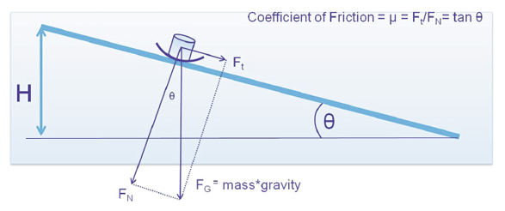
Methods of Measuring Friction
Microtribometer
A microtribometer is an instrument that directly measures the frictional force and the normal force in order to calculate the coefficient of friction.
Sliding speed: Test speeds have a large effect on the measured COF
Low speed as 0.01 mm/sec¹³ used to measure “boundary lubrication”
Higher speeds used¹⁰ to measure “mixed” or “hydrodynamic lubrication”
Normal Force Pressure: eyelid pressures are typically estimated at 1-7 kPa

Slide 44
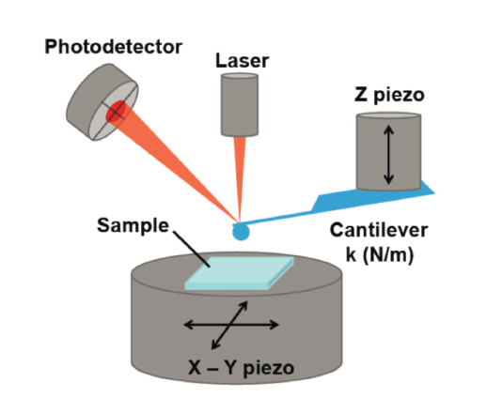
Inclined Plane Method
A quantitative method of determining contact lens friction using a PBS solution.
A clean glass plate is adjusted to a desired angle in a PBS bath.
The contact lens under test is placed at the top of the glass plate and a 0.8 gram stainless steel ferrule (0.88 kPa) is placed on the lens to initiate movement.
The tangent of the critical angle is a measure of the kinetic coefficient of friction

Slide 45
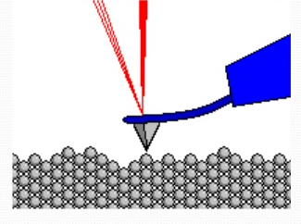
Measurement of surface topography
Atomic force microscopy (AFM) is mainly used in the topographic analysis of material surfaces on the nanometer scale.
This technique works by detecting the deflection of a weak cantilever, which supports a probe tip, as a function of the programmed motion across a sample surface.
AFM is a very powerful tool for high-resolution examination of the contact lens surface and also permits the analysis of surface topography and roughness by means of a non-destructive methodology

Slide 46
Lubrication: Lubrication between the contact lens and the eye is critically important
Finger Lubricity Method
A qualitative “finger rubbing” method has been described to determine contact lens lubricity.
Procedure :
In this method, contact lenses were rinsed overnight in a phosphate buffered saline (PBS) solution to remove any packaging solution, and the investigator rubbed the lens between their thumb and index fingers.
Rating: Lubricity was rated on Zero (most lubricious) to 4 (least lubricious) scale.
Advantages:
a simple, quick method that does not require any sophisticated instrumentation.
Disadvantages:
limited qualitative scale and not all lens types can be differentiated with this technique.

Slide 47
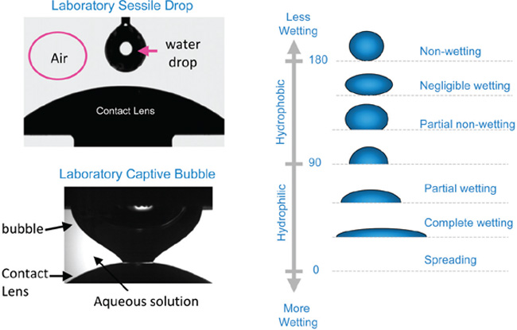
Contact Lens Wetting
Wettability is based on contact angles, which measure the area between the non-adhering part of a droplet and the surface on which it sits.
Contact angles can range from 0° (complete wetting) to 180° (non-wetting).
For silicone hydrogel materials, wettability is more difficult
and challenging to measure because when silicone hydrogel materials are exposed to air, there is rapid rotation of siloxane bonds and migration of these groups to the lens-air interface.
Measure Contact Angles:
Sessile drop method - measures the contact angle between a drop of water and a contact lens surface exposed to air.
Dynamic captive bubble technique -measures the contact angle between an air bubble and a contact lens surface in an aqueous environment.

Slide 48
Wetting agents
New soft contact lens materials with high water content surfaces or incorporated wetting agents such as poly(vinylpyrrolidone) (PVP) or poly(vinyl alcohol) (PVA) have been developed to reduce friction between the contact lens surface and the lid-wiper.
Wetting agents such as water-soluble surface-brushes are introduced, particularly for dry eye patients

Slide 49
Problems with Conatct Lenses
1.Tight lense syndrome
This may be because of tight fitting of lenses, or it may be related to increase in dryness of the lenses with the eye.
2.Corneal Ulcer
Over wear of lenses, improper cleaning of lenses leads to surface breakdown
3. Corneal swelling
Cornea becomes smothered by the lenses.
4. Eye redness

Slide 50
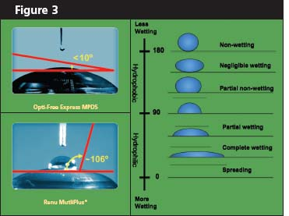
Questions??
1). What is importance of Tribology in medical devices or biological components ?
Ans: Many medical devices are involved with relative moving parts, either in contact to the native tissues or within the biomaterials, and often under loading. Important issues, such as friction and wear of the moving parts, Lubrication will not only affect the functions of these devices but also the potential adverse effects on the natural tissues.
2). What is the importance of lubrication in contact lens ?
Ans: Lubrication between the contact lens and the eye is critically important. Fluid film lubrication in the presence of the tear film ensures minimum friction, minimum Shear stress, smooth motion and negligible damage in the eye during blinking.
3). Brief about Wettability of contact lens ?
Ans: “Wettability” refers to the ability of the tear film to cover and maintain itself over the contact lens surface and is used to characterize the adherence of fluid to the lens surface. Wettability is determined by measuring the contact angle; the smaller the contact angle the greater the wettability and vice-versa.

Slide 51
SPHERICALLY CAPPED MEMBRANE PROBES FOR LOW CONTACT PRESSURE TRIBOLOGY
Clint Antony 131501008
09/04/2018

Slide 52
Introduction
Low contact pressure measurements are needed for biotribology studies on cells, cell layers, and tissues.
Such studies typically require low forces to achieve kPa range contact pressures, but such methods frequently come at the expense of contact area and, in turn, relevance.
In seeking lower contact pressures, the corresponding contact areas can become too small to be physiologically relevant or important.
This method creates probes that are thin spherical shells, specifically designed to create low contact pressures.

Slide 53
Application
The cornea is made up of moist epithelial cells that form a thin stratified layer on the exterior surface of the eye. This layer is protected by a mucinated aqueous tear film, and both vision and ocular health are dependent upon the stability of the tear film.
Under conditions of contact lens use, disruption of the tear film can lead to discomfort and cell damage .
Contact lens design and material selection balances contact pressure and lubricity in an effort to maintain comfort and function over a wide range of sliding conditions during ocular movements while minimizing damage to the epithelia .
The contact pressures exerted on the cornea by the eyelid are estimated to be 1 –5 kPa and may increase to 12 –18 kPa with the inclusion of a soft hydrogel-based contact lens.
Matching the contact pressure conditions is essential for in vivo, ex vivo, and in vitro studies that aim to collect physiologically relevant friction measurements

Slide 54
Constraints
In vitro biotribological experiments using a spherical probe sliding against a cellular monolayer are desirable for in situ studies.
However, even the softest hydrogel materials have been observed to severely damage the cellular monolayer during sliding due to high contact pressures that result from the Hertzian mechanics of a solid spherical probe.
As an example, a hydrogel probe with an elastic modulus on the order of 20 kPa and a diameter of a few millimeters can routinely produce contact pressures in excess of 10 kPa at normal loads below 500 μN .
For cells grown in culture, setup of in situ experiments often involves metrology that is not optimal for high-precision tribological experiments, and small misalignments in setup over long sliding distances can cause large variations in contact pressure.
Notes:
Challenging for microtribometers.

Slide 55
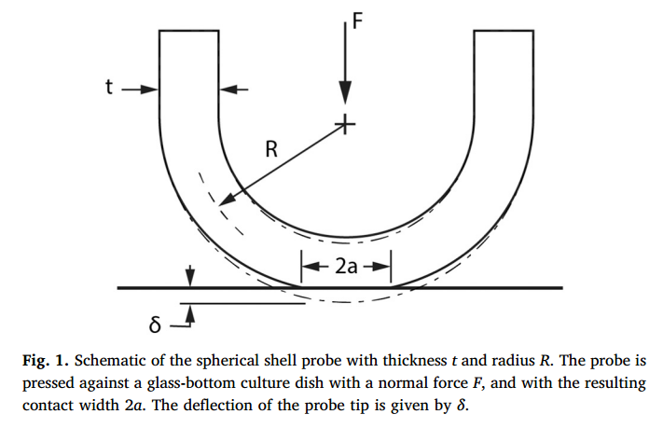
Geometry Adopted
This geometry capitalizes on the mechanics of the geometry such that, at low forces ( μN) and strains, the contact pressure is predicted and found to be constant and independent of the applied load.
Such a probe allows the contact area to fluctuate with variations in applied load without changing the average contact pressure.

Slide 56
Material Preparation
Method 1- Casting in a Mold:
Molding is done using standardised polymerisation technique with 1mm nylon rod inserted into the mold.
Probes were made of 7.5% (w/w) polyacrylamide and were doped with 25 nm green fluorescent beads prior to polymerization.
The embedded fluorescent beads allowed the probes to be imaged by a confocal microscope when submerged in water.
Elasticity Modulus of approximately 20 kPa.
The rod and probe were then removed from the mold and the molded probe was fitted to a nylon fastener

Slide 57
Material Preparation
Method 2- 3D Printing in a soft granular microgel media liquid-like Solid (LLS)
Used polyethylene glycol (PEG) hydrogel.
PEG hydrogels were prepared at
~11 wt% poly(ethylene glycol) acrylate monomethyl ether
~2.5 wt% poly(ethylene glycol) diacrylate concentration in ultrapure water (18.2 M Ω)
less than 0.05 wt% Irgacure D-2959 was added as an ultraviolet (UV) photoinitiator.
The probe was printed in a microgel medium made of 0.1% ETD2020 carbomer suspended in ultrapure water. A steel needle with a 190 μm inner diameter was used for printing, and the resulting printed probes were cured for 5 min under UV illumination.
The probe was removed from LLS media, swelled to equilibrium in ultrapure water for 24 h.

Slide 58
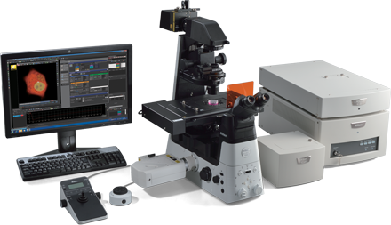
Procedure
Indentations were performed on a custom micro-indenter described in Schulze et al. attached to a Nikon C2 Eclipse Ti confocal laser scanning microscope.
Z- stack:1300 μm × 1300 μm × approximately 2 mm
The hydrogel probe was then loaded against a glass-bottom culture dish coated with Pluronic® F-127 to minimize adhesion effects under submerged conditions (Fig. 2b).
The applied load was monotonically increased from 50 μN to 1000 μN through load-controlled, closed-loop feedback control.
At each discrete indentation load, confocal imaging with fluorescein isothiocyanate filtering was used to reconstruct a 3D representation of the deformation and contact area using the embedded fluorescent green particles

Slide 59
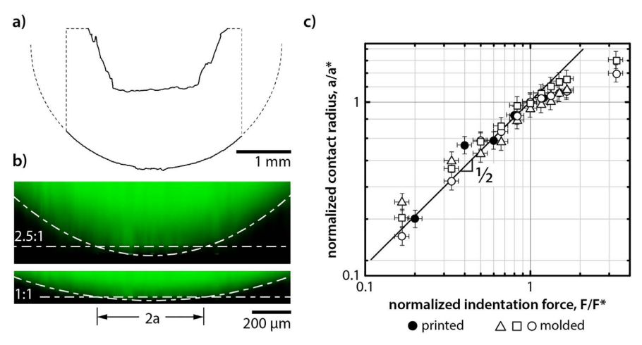
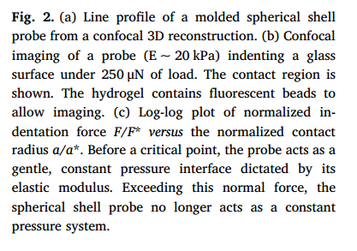
Observations

Slide 60
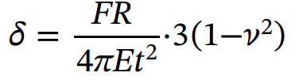
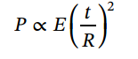
Calculation
Roark's analysis of a simply supported circular plate along the edge with a point load gives the maximum deflection δ as shown by:
where F is the force, R is the radius of curvature, E is the elastic modulus, t is the thickness of the spherical shell, and ν is the Poisson ratio.
Pressure is independent of contact area.

Slide 61
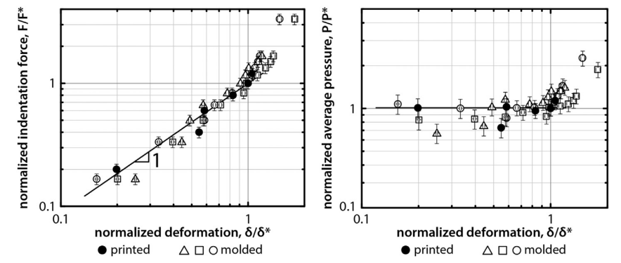
Results

Slide 62
Result:
Pressure is independent of the applied force and the contact area (under low deformation) which has been proved theoretically and experimentally.
Low contact pressures were achieved. At the critical force of 300μN (for molded) and 250μN (for 3D printed) and critical radius of 300μm, the contact pressure was less than 2kpa.
Usage of this technique can avoid pressure variation.

Slide 63
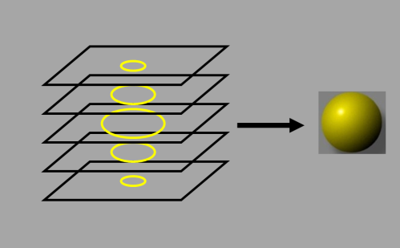
Questions
What is the advantage of using shell structured probe?
The shell structured probe can produce very low contact stresses by controlling its geometric parameters alone and is independent of the applied load and contact area for low loads.
What is meant by z – stack?
By recording images at different focal planes the entire sample volume can be rendered and visualized. These images constitute a Z-stack (see fig). These “Z stacks” are generated by incrementally stepping through a sample using a focal drive. These images are then processed to give a higher depth to the image.

Slide 64
Current Research
Currently, biotribology is one of the most exciting and rapidly growing areas of tribology.
Here a short review of the current status of biotribology research and highlights future directions are discussed.
Three specific examples of biotribology research are considered; joint, skin and dental, while other areas are briefly discussed.

Slide 65
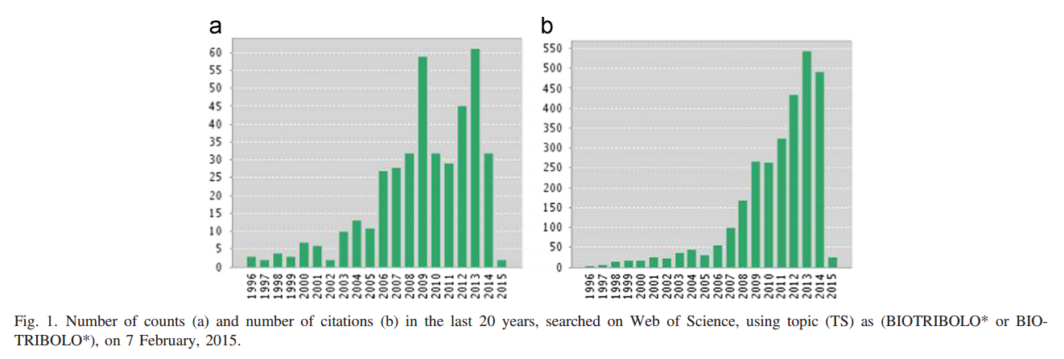
As of 7th February 2015 a total counts of 422

Slide 66
Current Research
In addition, about 10 scientific books or edited volumes such as:
Advance in Medical Tribology,
Human Joints and Their Artificial Replacements,
Bioengineering of the Skin,
Biological Micro- and Nano-tribology,
Dental Biotribology
have been written on this subject since the 1970s

Slide 67
Current Research
A number of international forums, workshops and symposia have been held on biotribology or related to biotribology. For example, in 1967, the symposium on Lubrication and Wear in Living and Artificial Human Joints was arranged and held in London by the Institution of Mechanical Engineers in collaboration with the British Orthopaedic Association, which attracted over 160 delegates (The Institution of Mechanical Engineers 1967).
In 1996, are port from a workshop on dental tribology by Lloyd et al was published. Eighty delegates contributed to a valuable discussion, the purpose of which was to bring together tribologists , clinicians and dental material scientists to gather to discuss the fundamental mechanisms of wear and how to obtain manifestations and conduct measurements of wear in dentistry.

Slide 68
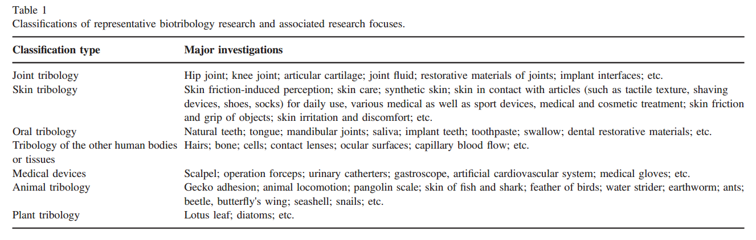
Classifications and focuses of current research
Generally categorised as:

Slide 69
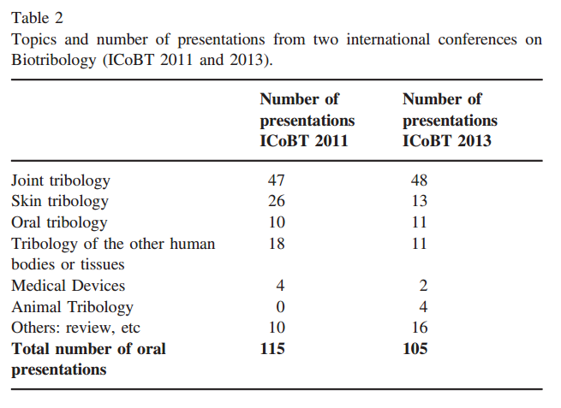
Important Topics:

Slide 70
References:
Spherically Capped Membrane Probes For Low Contact Pressure Tribology by Samantha L. Marshalla, Kyle D. Schulzea, Samuel M. Harta, Juan Manuel Urueñaa, Eric O. McGheea, Alexander I. Bennetta, Angela A. Pitenisa, Christopher S. O'Bryana, Thomas E. Angelinia, W. Gregory Sawyer
Biotribology: Recent progresses and future perspectives by Z.R. Zhoua,n, Z.M. Jin
Cartilage and joint Lubrication: https://www.ncbi.nlm.nih.gov/pmc/articles/PMC2758165/
Ocular: https://www.clspectrum.com/supplements/2013/june-2013/the-world-x0027;s-first-and-only-water-gradient-c/font-color-000000-special-edition-2013-font-(9), https://www.clspectrum.com/supplements/2011/september-2011/special-edition-2011/font-color-000000-special-edition-2011-font-(10).
Shoulder: https://www.sciencedirect.com/science/article/pii/S2352573817300495.

